Slide 1
Don't Overfit! II
Data from https://www.kaggle.com/competitions/dont-overfit-ii

Slide 2
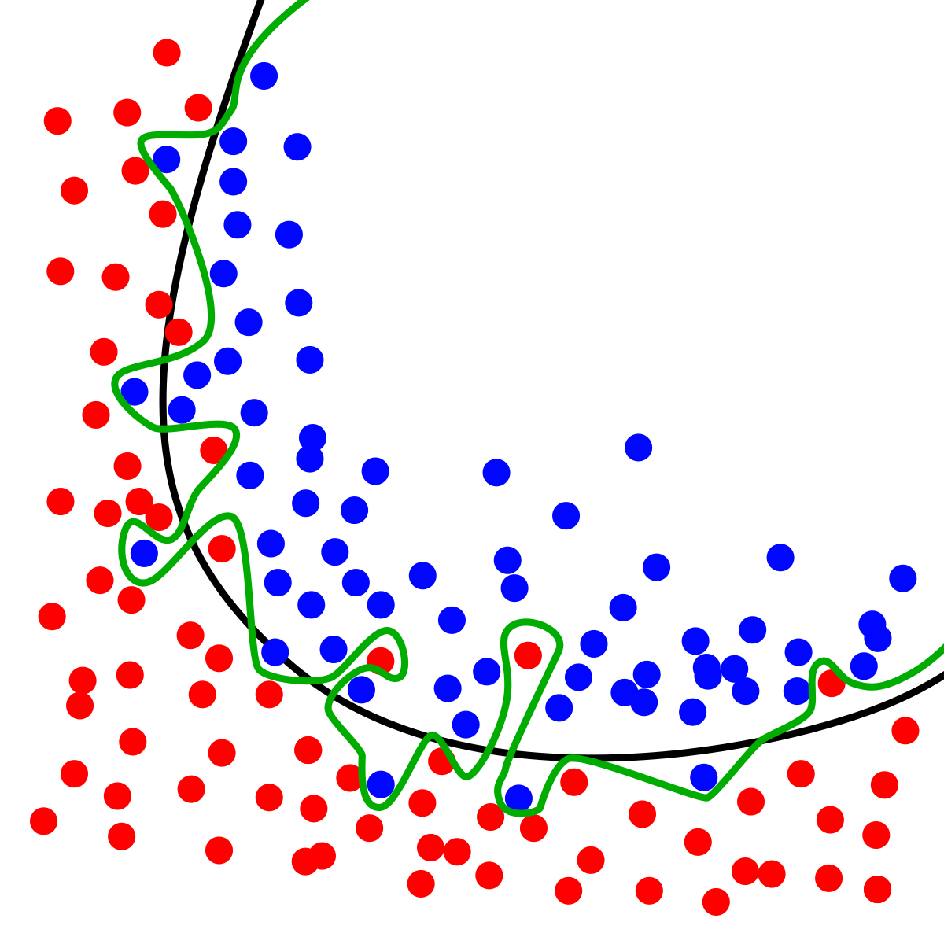
Agenda
Introduction
Data Quality
Data Preparation
Comparing Models
Next Step

Slide 3
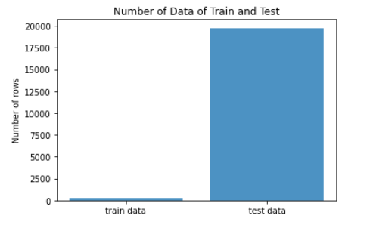
Introduction
Goal:
Predict 20,000(rows) * 300(columns) data
using 250 rows of training sample without overfitting
Original Competition: - two $250 prizes
- 12 year ago

Slide 4
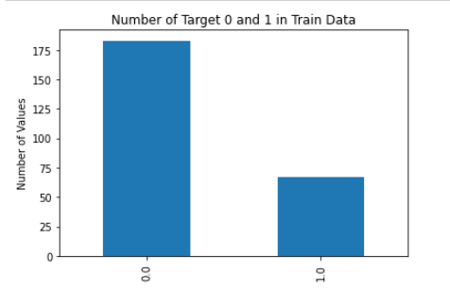
Data Quality
All 300 features are continuous variables without null values
Target variable contains only 0 and 1
（Unblanced)

Slide 5
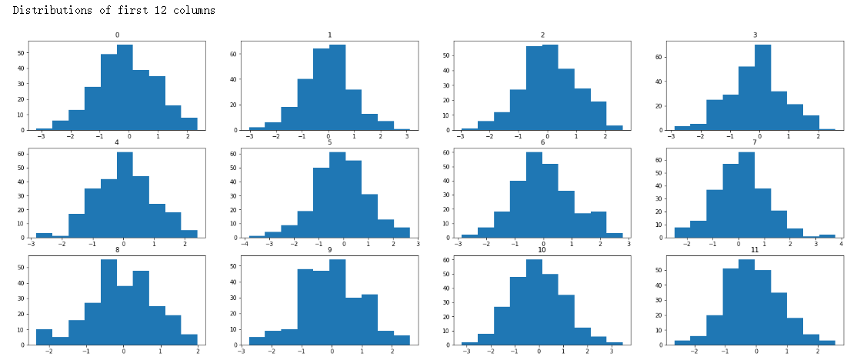
Data Quality

Slide 6
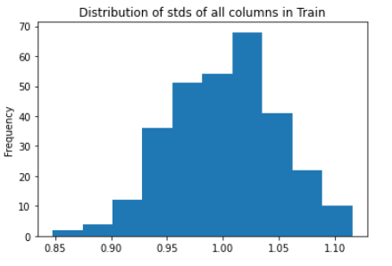
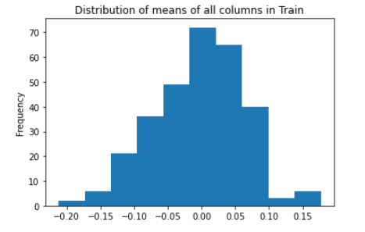
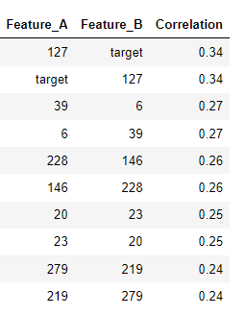
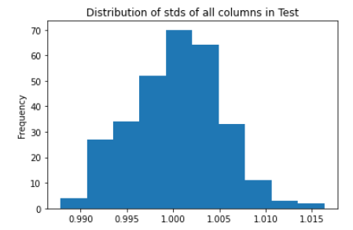
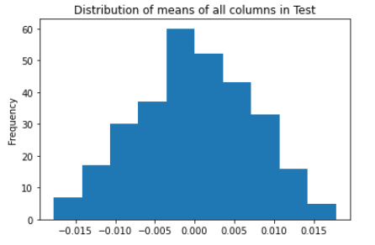
Data Quality
Features in Train and Test data are very similar

Slide 7
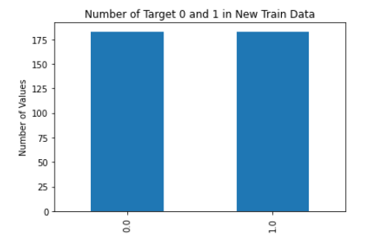
Data Preparation
Feature selection
SMOTE
May improve the performance of the model
RFE function (Recursive Feature Elimination)
Select Top 150 features
Synthetic Minority Oversampling Technique
Oversample the minority class
Prevent overfitting in some degree

Slide 8

Data Processing
Original Train Data
Feature selection
SMOTE

Slide 9
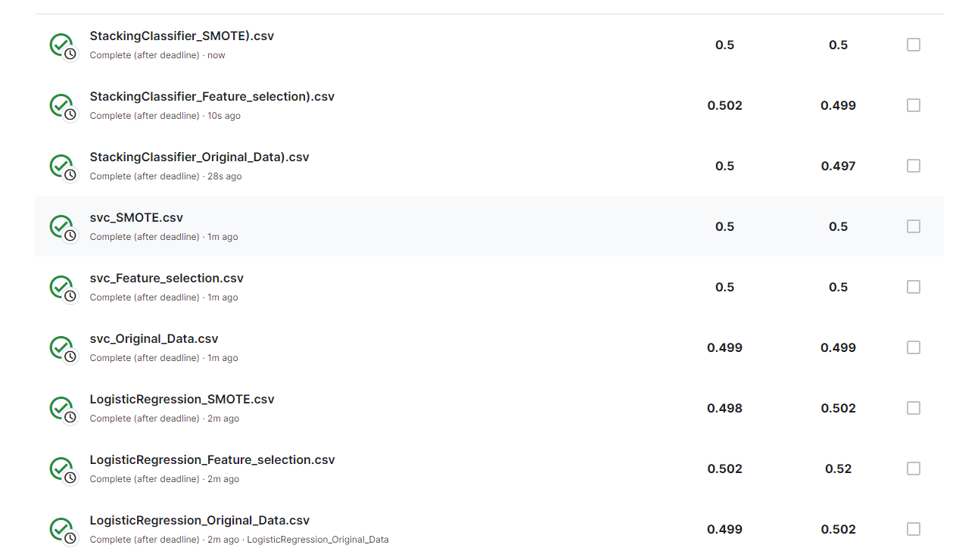
Comparing Models

Slide 10
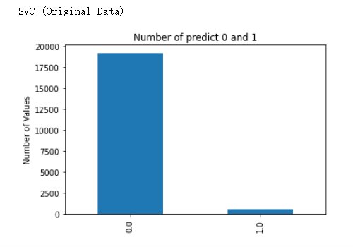
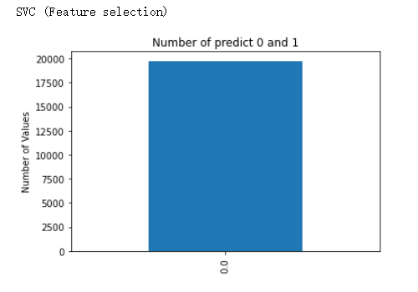
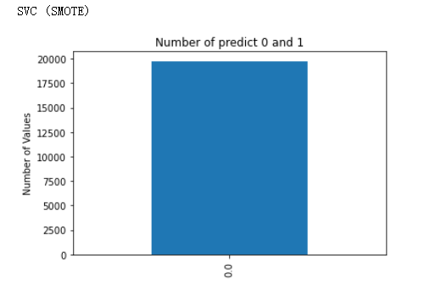
Comparing Models
SVC

Slide 11
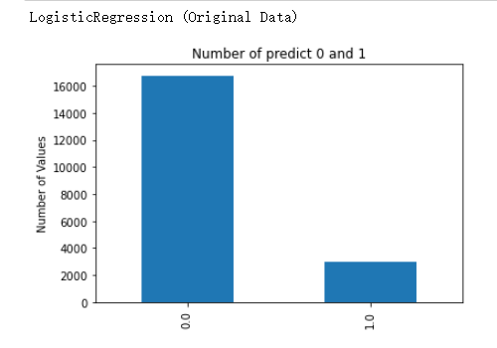
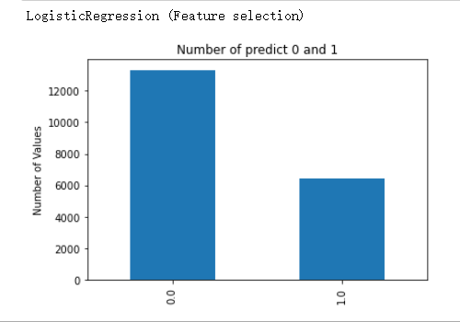
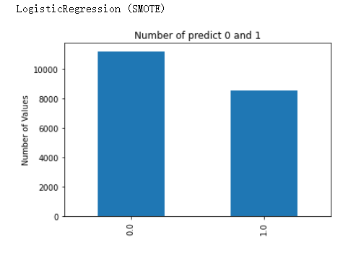
Comparing Models
Logistic Regression

Slide 12
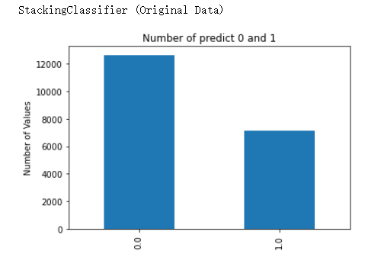
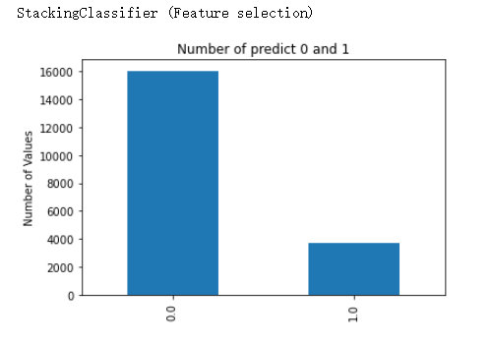
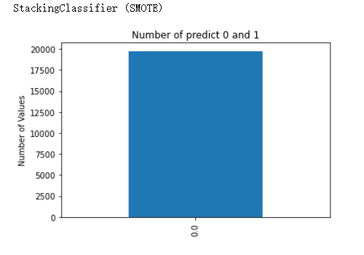
Comparing Models
Stacking Classifier

Slide 13
Next Steps
Try new models
Combine feature selection and SMOTE
Further Analysis using Feature Selection
Early stopping
LB probing strategies

